Slide 1

Real-Time Rendering
Session 2: Before Rendering & Occlusion
Mehrdad Jafari
Spring 2023

Slide 2
Table of Contents
Intro
Before Rendering
Geometry Rendering
Rasterizing & GBuffer
Textures
Pixel Shaders & Materials
Reflections
Static Lighting/Shadows
Dynamic Lighting/Shadows
Fog & Transparency
Post Processing

Slide 3
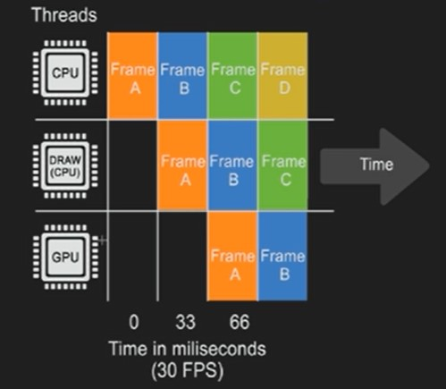
Before Rendering & Occlusion

Slide 4
Before Rendering & Occlusion
Frame 0 - Time 0 - CPU
Before we render anything, we need to know where everything is
Animations
Positions of models and objects
Physics
AI
Spawn & destroy, hide and unhide
Anything related to the positions of objects

Slide 5
Before Rendering & Occlusion
Frame 1 - Time 33 ms - Draw thread (mostly CPU)
We need to know what to include in rendering, which is:
OCCLUSION PROCESS!

Slide 6
Before Rendering & Occlusion
Occlusion process builds up a list of all visible models/objects
Process happens per object, not per polygon
4 Stage process in order:
Distance culling
Frustum culling
Precomputed visibility
Occlusion culling

Slide 7
Before Rendering & Occlusion
Occlusion performance implications
Set up distance culling (not set by default)
Mostly CPU bound, but has some GPU impact
Large open environments don’t occlude well
Any visible thing occludes, even particles!
Large models will rarely occlude and thus increase GPU
Combining models to large ones will lower the CPU impact

Slide 8
Coming up
Geometry Rendering

Slide 9
Thank you for your attention!

